Slide 1
Introduction to control systems
The first applications of feedback control appeared in Greece 300-1 BC ( a float regulator mechanism).
The first feedback system invented in modern Europe was a temperature regulator in Holland.
Before 1868 control systems were developed through intuition and invention.
Mathematical theory started to develop using differential equations to model control systems (J.C. Maxwell).
Prior to WW II: development of telephone system and electronic feedback amplifiers at Bell Lab (Bode, Nyquist, Black).

Slide 2
During WW II: impetus to the theory and practice of automatic control: auto pilots, radar control, military applications.
Extensive development of the theory was done in the 1950s (root locus approach).
In the 1970s, 1980s: further advances due to the utilization of digital computers for control components, simulation of control systems, state variable models, optimal control, robust control system design.
In the 1990s: automation using automatic control systems, reliable and robust systems in manufacturing, automobiles, airplanes,…
First autonomous rover vehicle to explore Mars.

Slide 3

Basic Concepts
This course is concerned with the analysis and design of closed-loop control systems.
Analysis: given a system, determine its characteristics or behavior.
Design: specify the desired system characteristics or behavior, must configure (design) the system so that it exhibits these desired quantities.
Closed-loop system: system inputs are functions of system outputs.
Example: An automatic temperature control system in a house.
Temperature in a room => Sensor => feedback to input
If activate the furnace else deactivate the
furnace.

Slide 4
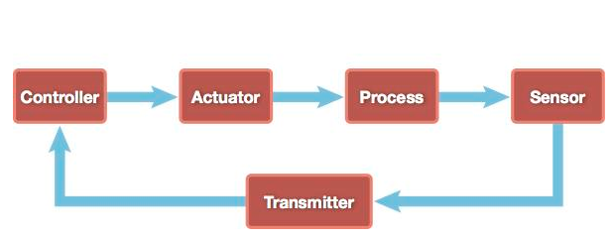
Closed Loop Control System
It consists of five fundamental elements :The process that is to be controlled. An instrument with a sensor that measures the condition of the process. Transmitter that converts the measurement into an electronic signal. Controller that reads the transmitter's signal and decides whether or not the current condition of the process is acceptable. An actuator functioning as the final control element that applies a corrective effort to the process per the controller's instructions.

Slide 5
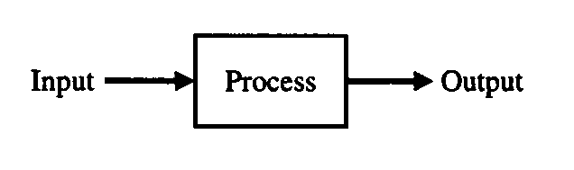
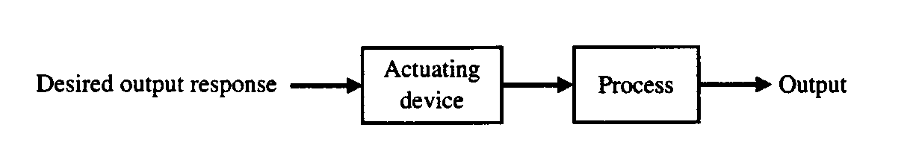
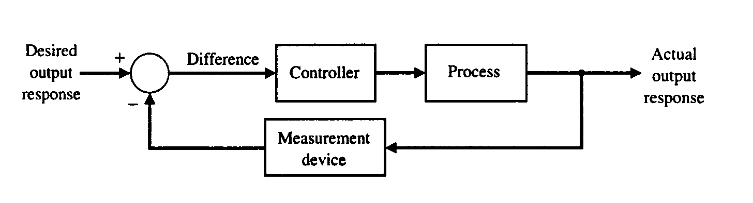
Process (plant) to be controlled:
Open-loop control system:
Closed-loop control system:

Slide 6
Control systems are divided into two classes:
a) If the aim is to maintain a physical variable at some fixed value
when there are disturbances, this is a regulator.
Example: speed-control system on the ac generators of power utility companies.
b) The second class is the servomechanism. This is a control system
in which a physical variable is required to follow (track) some
desired time function.
Example: an automatic aircraft landing system, or a robot arm designed to follow a required path in space.
Compensator = controller
Actuator = device to drive the plant (process)

Slide 7
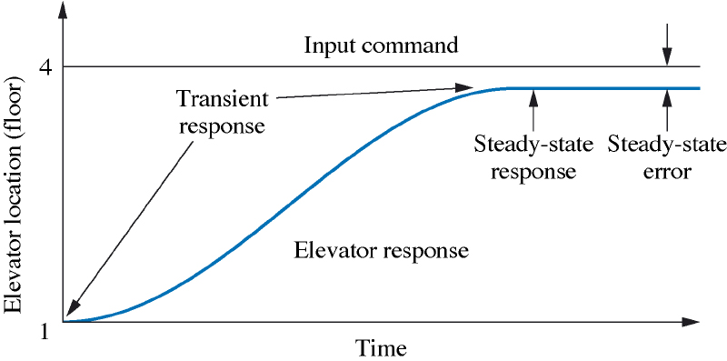
Analysis and Design Objectives:
Transient Response.
Example: electric elevator.
A slow transient response makes passengers impatient; a very rapid response makes them uncomfortable; if it oscillates about the arrival floor for more than a second, bad feeling can result. Objective 1: desired transient response.
Steady-state Response. This should resemble the input and is what remains after the transients have died down. Example of the elevator: it must stop near the 4th floor (e.g. stead-state error is less than 1 cm). Objective 2: desired steady-state response.
Stability. Total Response = Natural Response + Forced Response
in O.D.Es these are homogeneous and particular solutions. For control systems, the natural response must approach zero leaving only the forced response. If the natural response grows without bounds we have instability. Objective 3: desired stable response

Slide 8
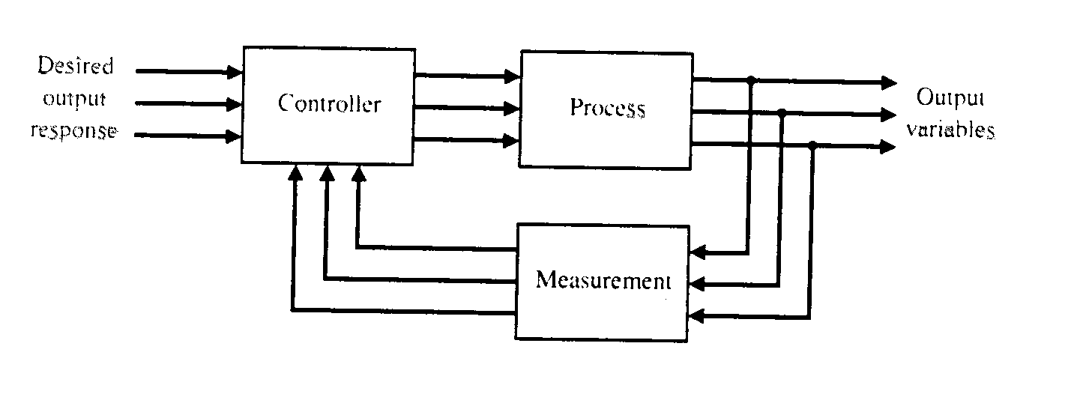
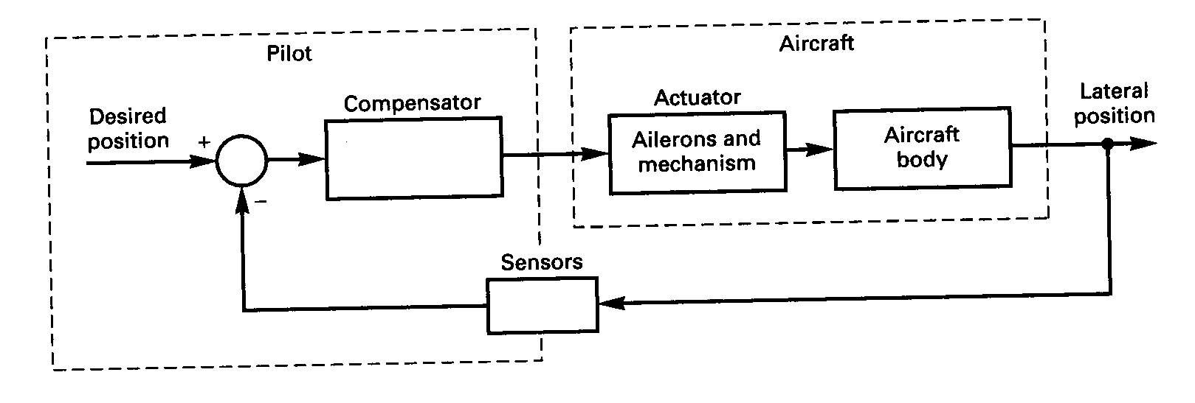
Multivariate control system:
Example: this example only considers the problem of keeping the aircraft on the centerline of the runway (controlling the lateral position).

Slide 9
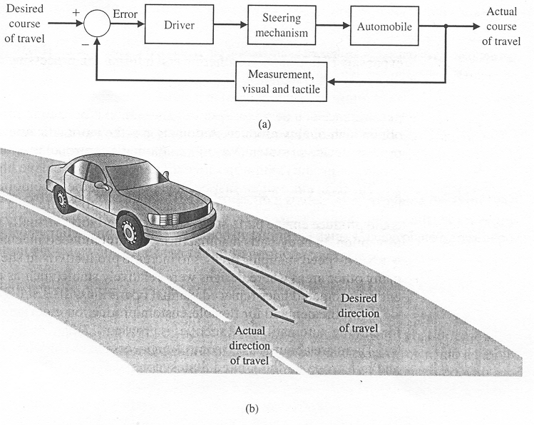
Examples of modern control systems: automobile automatic steering control system.

Slide 10
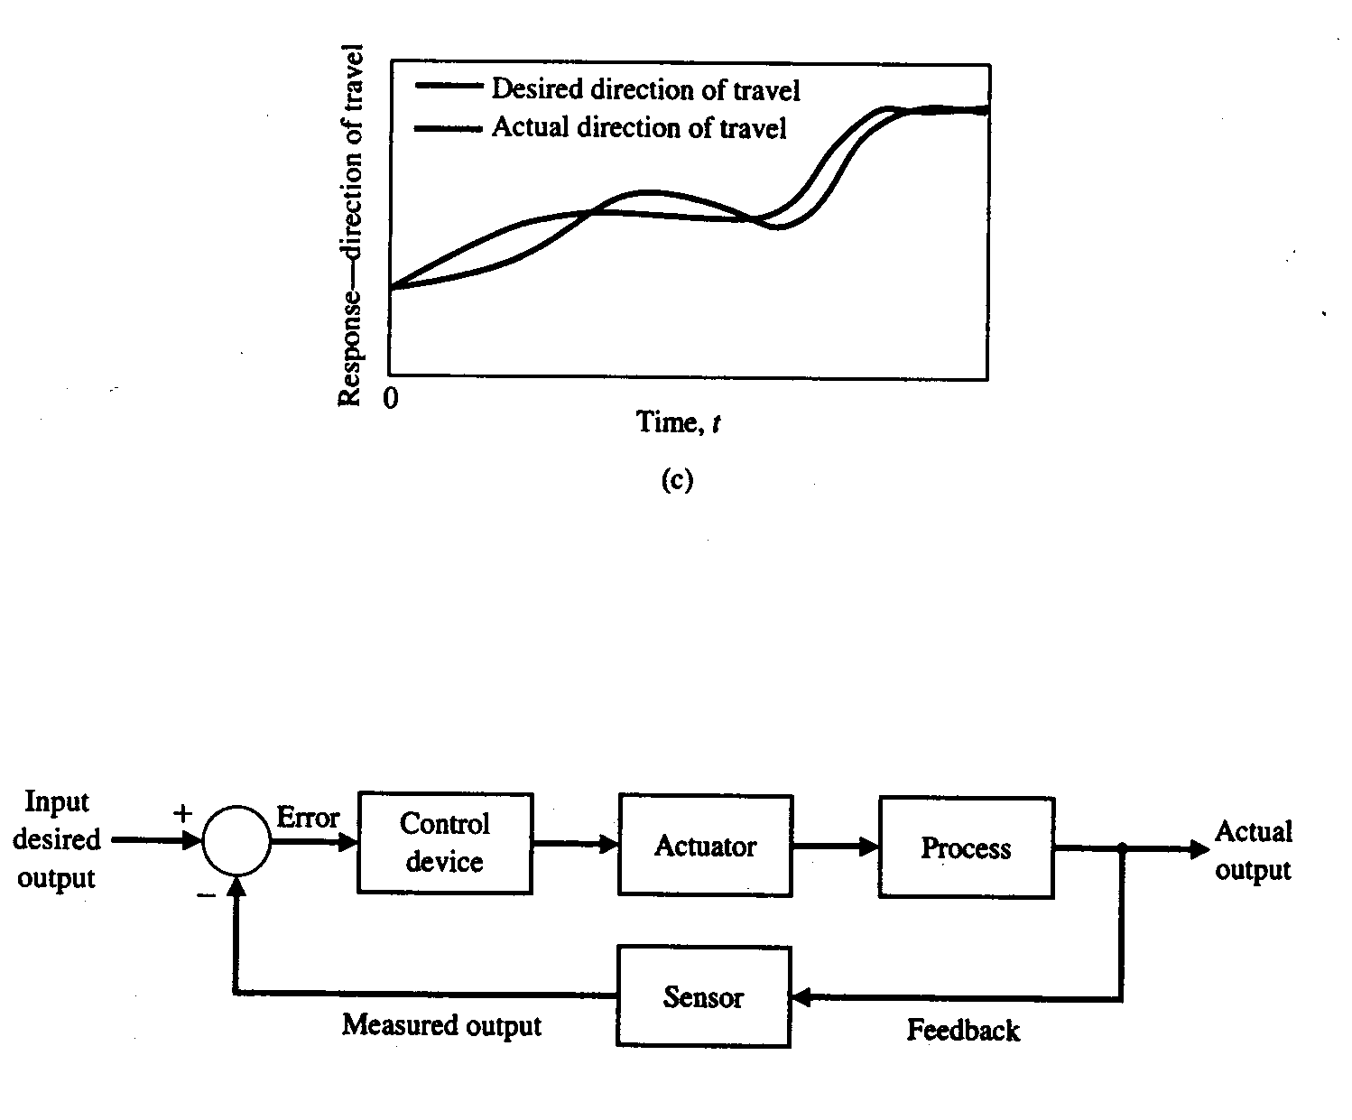

Slide 11
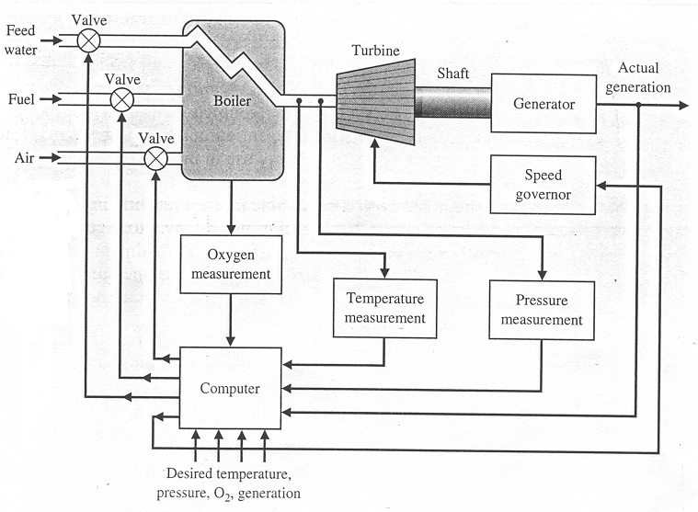
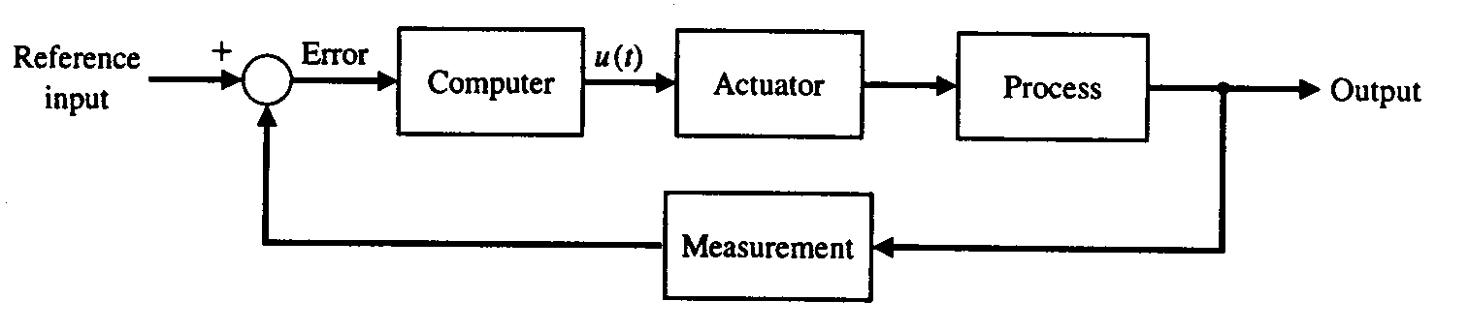
Examples of computer control systems: coordinated control system for a boiler generator.

Slide 12
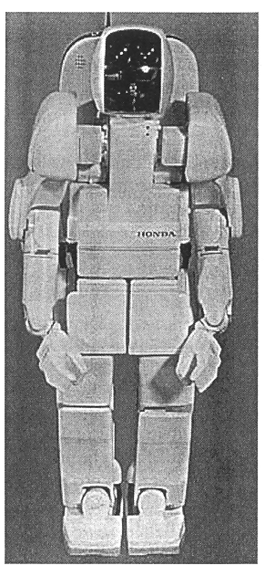
Automatic assembly and robots.
http://video.google.com/videoplay?docid=1210345008392050115
Honda P3 humanoid robot (predecessor of Asimo)

Slide 13
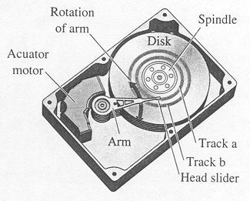
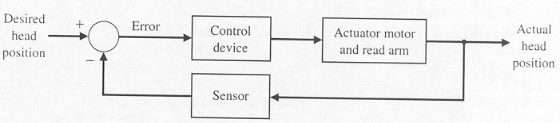
Control System Design
Disk drive read system.
The variable to control is
the Position of the reader
head.
A closed control System
can be applied for this purpose.

Slide 14
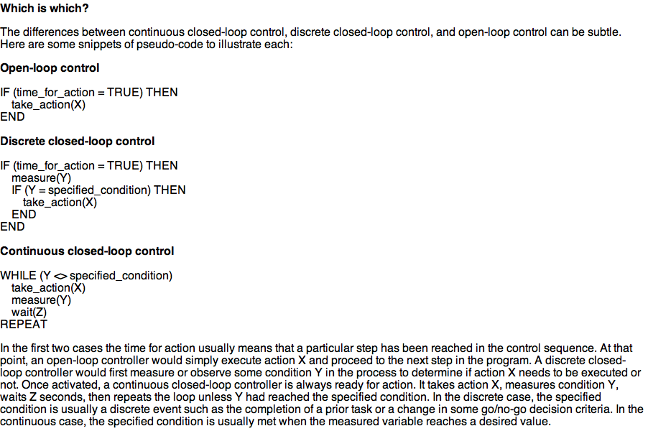
Open loop vs. closed loop

Slide 15
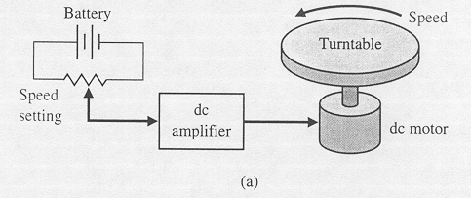
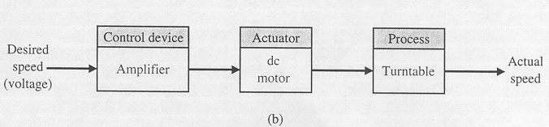
DC motor speed control system. (Turn table speed control), Applications: CD players, Disk drives, Phonograph Record Players….)
Open loop speed control: A battery source provides a voltage which is proprtional to the desired speed, this voltage amplified and applied to the DC motor.

Slide 16
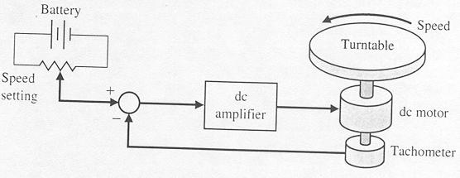
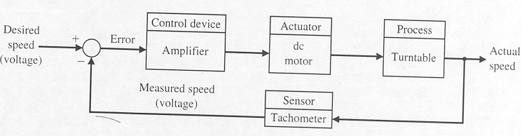
DC motor speed control system. (Closed Loop Speed Control)
A sensor (tachometer) provides an output voltage proportional to the actual speed, this voltage is compared to the desired voltage to produce the error signal, and error signal is applied to the control device (amplifier), then it is applied to the motor. This control is superior to the open loop control.

Slide 17
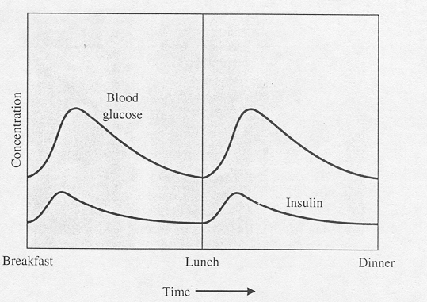
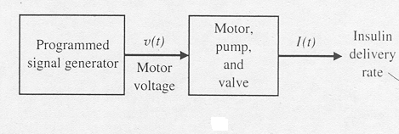
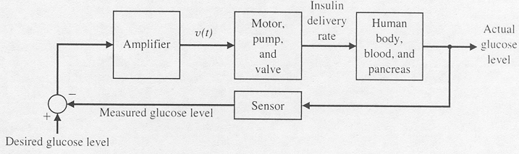
Insulin delivery control system.
The blood glucose and insulin
of a healthy person
The variable to control is the
blood glucose concentration
This Diagram shows the open
loop control design for system
This Diagram Shows the closed loop design, it uses a sensor feedback

Slide 18
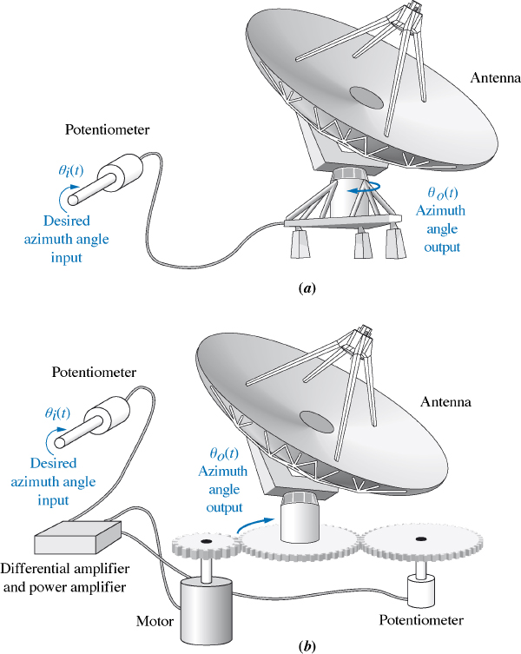

Slide 19
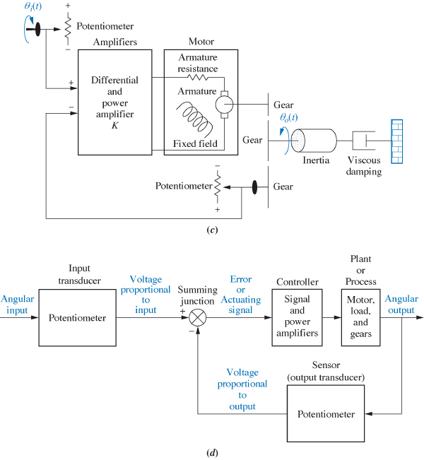

Slide 20
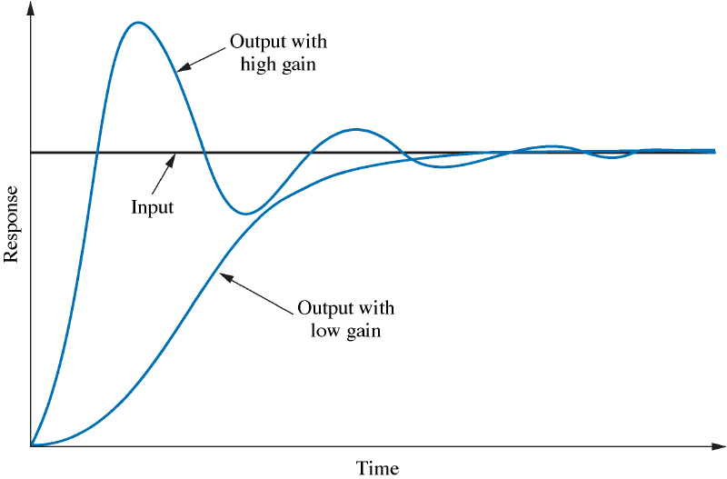
Time Response for Unit Step Input

Slide 21
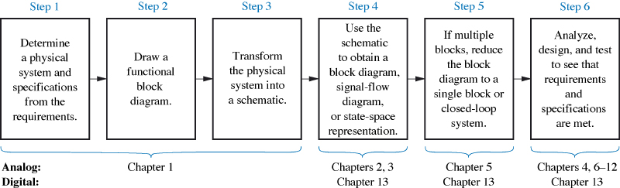
Design Stages for the Antenna

Slide 22
